Slide 1
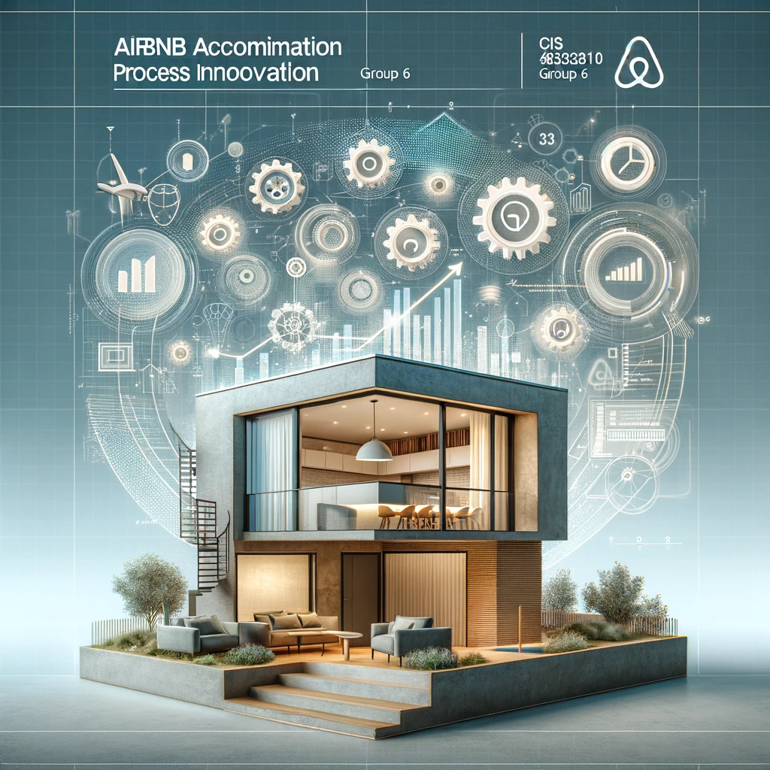

AIRBNB ACCOMODATION
CIS 8010: Process Innovation
Group 6​
Project Milestone 2
Anitta Varghese
Md Kamruzzaman Kamrul
Ritesh Sengar
Bach Hong

Slide 2
The Airbnb service experience begins with a customer initiating the account creation process. This process takes place in the Airbnb Service Provider Pool, specifically within the Account Department lane. The customer starts by sending an Account Creation Form to the Account Department. The department's staff confirms the account creation using the information provided in the form. Following this, the Account Department sends a request back to the customer for ID verification. Upon receipt of the ID from the customer, the department undertakes a critical step of verifying the match between the ID and the account information provided. If there are discrepancies, and the ID Verification is not approved, the department requests revised documentation. This could be a Moment of Struggle for Customer since the verification process is taking too long. This step can loop back to the verification stage if necessary. Once the ID is successfully verified and approved, the department saves the customer's information, finalizes the account creation, and thereby concludes the registration process.
After an account is created, the main booking process starts in the Booking Department. This process is triggered when a host sends housing information to the Booking Department. The department then takes the responsibility of displaying this available housing data to potential customers. This could be a Moment of Struggle with Booking discrepancies between different platforms. When a customer selects a location, the Booking Department facilitates a platform for communication between the host and the customer. At this juncture, if the host rejects the booking, the customer is informed about the rejection and redirected back to the booking screen. This could be a Moment of Struggle for the customer since the rejection process takes too long and customers require constant booking. If the host accepts the booking request, the department transfers this booking information to the Payment Processing Department
Step 2-a: Service Provider Narrative
(Part 1)

Slide 3
Step 2-a: Service Provider Narrative (Part 2)
The Payment Processing Department starts the payment process by presenting detailed payment information to the customer. This process includes calculating the tax based on the property’s location and providing a comprehensive payment total inclusive of tax. This could be a Moment of Struggle for customers since the detailed payment can be different from the original price due to various fees (cleaning, supplies, etc). The customer is then expected to enter payment details within a 20-minute window. Failure to do so results in a system time-out, ending the process. Upon receiving the payment details, the department verifies them with their banking system. If the payment is declined, the process loops back to the payment screen for the customer to retry. On successful payment, multiple activities occur simultaneously: the Payment Department allocates a portion of the payment as profit, settles tax obligations, and ensures the host receives their share of the payment. Simultaneously, the Booking Department finalizes the process by creating and sending booking confirmation details to the customer.
After the customer’s stay, the Account Department collects reviews from both the host and the customer, an essential step for continuous improvement and quality assurance. Additionally, the Payment Processing Department generates the final receipt detailing all costs incurred during the stay and sends this to the customer. This final step marks the completion of the Airbnb service process.

Slide 4

Stage 1: Front Stage Processes and Service Interfaces (Account Creation)
Service Interface: Customer initiates the account creation process on Airbnb.
Front Stage Process: The process occurs within the Airbnb Service Provider Pool, specifically in the Account Department lane.
Customer Touchpoints (Moment of Struggle): Moment of Struggle occurs during ID verification if discrepancies arise, leading to potential delays.
Performer Roles (Human, IT): Account Department staff confirm account creation, and IT systems are utilized for ID verification.
Human Activities: Customer submits an Account Creation Form, and department staff verify information.
IT Activities: Systems verify the match between the ID and account information.
Workflows: If ID Verification is not approved, the process may loop back to the verification stage.
Decision Points: ID Verification approval or rejection based on match.
Exceptions (Service Failure): If discrepancies persist, revised documentation is requested.

Slide 5

Stage 2: Main Booking Process
Service Interface: Booking process begins after account creation.
Front Stage Process: Main booking process occurs in the Booking Department.
Moment of Struggle: Arises if there are discrepancies between housing data on different platforms.
Performer Roles (Human, IT): Booking Department manages housing information, facilitates communication, and involves IT systems for platform operation.
Human Activities: Host sends housing information, customer selects a location, and communication is facilitated.
IT Activities: Displaying available housing data and facilitating communication between host and customer.
Workflows: If a host rejects a booking, the customer may face a Moment of Struggle, and the process redirects back to the booking screen.
Decision Points: Host accepting or rejecting the booking request.

Slide 6
Stage 3: Payment Processing
Service Interface: Payment process triggered after successful booking.
Front Stage Process: Payment Processing Department manages payment details.
Customer Touchpoints (Moment of Struggle): Moment of Struggle occurs during detailed payment information presentation and potential discrepancies.
Performer Roles (Human, IT): Payment Processing Department presents payment information, verifies payment details with banking system, and allocates portions.
Human Activities: Customer enters payment details within a 20-minute window.
IT Activities: Verification of payment details with banking system.
Workflows: If payment is declined, process loops back to payment screen for customer retry.
Decision Points: Approval or rejection of payment.

Slide 7
Stage 4: Post-Stay Processes and Reviews
Service Interface: Post-stay processes commence after successful payment.
Front Stage Process: Account Department collects reviews, and Payment Processing Department generates final receipt.
Customer Touchpoints (Moment of Struggle): Potential Moment of Struggle during the review collection and receipt generation.
Performer Roles (Human, IT): Account Department staff collect reviews, and Payment Processing Department generates final receipt.
Human Activities: Collecting reviews from host and customer.
IT Activities: Finalizing receipts and sending confirmation details to the customer.
Workflows: Continuous improvement and quality assurance through reviews collection.
Decision Points: Completion of the Airbnb service process marked by receipt generation.

